Slide 1
Municipal Grant Program – Grants to Organizations
Final Reporting
www.leduc.ca

Slide 2
Overview
The City of Leduc provides funding support through the Municipal Grant Program
The purpose of this PowerPoint is to provide an overview of the process for:
General Grants to Organizations (GTO)
Final Reporting
Final Report Deadline – January 31, 2025

Slide 3
Overview
Organizations on current funding are REQUIRED to provide the following in their Final Reporting:
Final Report Document
Financial Documentation – Attach (Most Current):
Income Statement
Balance Sheet
Final Report Budget Template
All Financial Statements require independent review and signatures by two (2) Board Members other than the Treasurer
Failure to provide Final Reporting & Supporting Documents or incompleteness will affect future funding
Final Reports must be submitted to Grants@Leduc.ca by January 31, 2025
All must be submitted electronically (Handwritten or faxes will not be accepted)

Slide 4
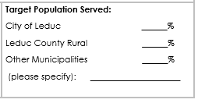
Final Report Document: Target Population Page 1
City of Leduc – residents of Leduc that live within City limits
Leduc County Rural – residents of Leduc County that live within the rural region
Other Municipalities Served – Specified Examples: Beaumont, Devon, Wetaskiwin, Calmar Thorsby etc.

Slide 5
Income Statement
Details of an organization’s revenues and expenditures over a period of time. It reflects if there is a Net Profit or Loss
Total Revenues - Expenses = Net Profit (or Loss)
It can also be referred to as:
profit/loss statement
income/expense statement
statement of operations
Non-Profit Organization Example
STATEMENT OF OPERATIONS
For the Year Ended December 31, 2024
REVENUE |  | 2023 | 2024
 | Workshops & Registration Fees | $3,025 | $3,525
 | Competition Meet | 5,450 | 7,000
 | Fundraising 50/50 Raffle, Bottle Drive & Events | 5,150 | 5,300
 | Donations/Sponsorships | 10,000 | 10,000
 | Casino | 15,555 | 5,300
 | Bingo | 15,987 | 15,675
 | Grants Proceeds | 15,000 | 14,000
 | Interest Revenue | 1,500 | 1,500
 | Board Room Rental | 750 | 800
Total Revenue |  | $72,417 | $73,334
EXPENSES
 | Wages & Benefits | $13, 381 | $13,185
 | Telephone & Utilities | 18,060 | 18,266
 | Competition | 3,199 | 2,029
 | Federation Dues | 6,104 | 3,302
 | Mortgage Interest | 14,119 | 20,060
 | Building Maintenance & Janitorial | 5,313 | 7,678
 | Office & Supplies | 925 | 755
 | Bank Charges | 481 | 353
 | Insurance | 3,932 | 3,883
 | Advertising & Marketing | 719 | 594
 | Staff Courses & Training | 690 | 324
 | Fundraising | 862 | 1,146
 | Bad Debt | 1,333 | 845
Total Expenses |  | $69,118 | $72,420
EXCESS OF REVENUE OVER INCOME |  | $3,299 | $914

Slide 6
Balance Sheet
(also referred to as the Statement of Financial Position)
Total Assets = Total Liabilities + Net Assets (Equity)
Assets – all resources owned and controlled by the organization. It can be grouped into 2 categories tangible (cash, physical, property etc.) and intangible (goodwill, copy rights, trade marks etc.)
Liabilities – all financial obligations of the organizations (loans etc.)
Net Assets (or Equity) – earnings left over
Non-Profit Organization Example
STATEMENT OF FINANCIAL POSITION
As at December 31, 2024
ASSETS |  |  | 2023 | 2024
Current
 |  | Cash | $ 31,490 | $65,661
 |  | Accounts Receivable | 4,770 | 2,473
Total Current Assets |  |  | 36,260 | 68,134
Long Term
 |  | Building | 452,701 | $405,718
 |  | Equipment & Furniture | 129,085 | 122,603
 | Total Long-Term Assets |  | 581,790 | 528,321
 | Total Assets |  | $ 618,050 | $ 586,455
LIABILITIES
Current
 |  |  | Deferred Revenue | $ 21,353 | $13,403
 |  |  | Mortgage | 14,525 | 12,753
 |  |  | Accounts Payable | 2,163 | 4,081
Total Current Liabilities |  |  |  | 76,082 | 30,237
Long Term
 |  |  | Mortgage - ATB | 130,773 | 146,186
 | Total Long-Term Liabilities |  |  | 130,773 | 146,186
 | Total Liabilities |  |  | $168,814 | $176,423
 | NET ASSETS
 |  | Investment in Building |  | $307,405 | $246,777
 |  | Investment in Furniture & Equipment |  | 129,085 | 122,603
 |  | Unrestricted |  | 12,746 | 50,655
 | Total Net Assets |  |  | $449,236 | $420,035
 | Total Net Assets and Liabilities |  |  | $618,050 | $420,035

Slide 7
Final Report Budget Template
This reporting must include planned ‘Submitted Budget’ and ‘Actuals’ for the year in which funding was approved
Submitted Budget – is what was requested in your application
Actuals – the actual revenue/expenses that we generated throughout your funding year
Ensure that all revenues sources are listed and described
All City of Leduc in-kind support or rental agreements or leases are to be listed separately and described

Slide 8
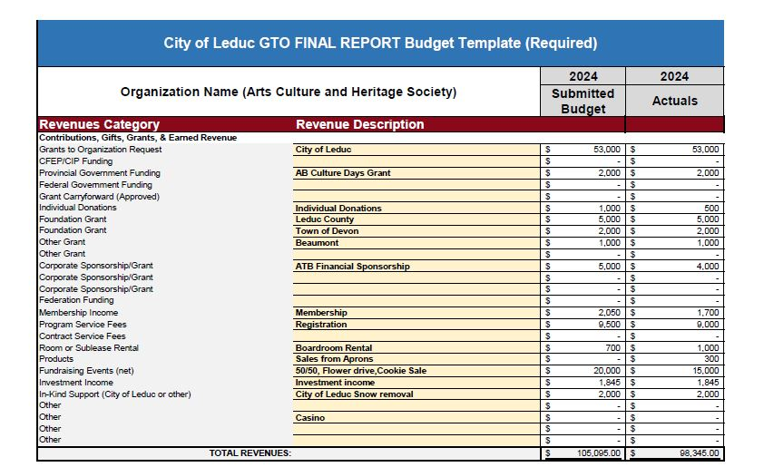
Final Report Budget Template
– Example

Slide 9
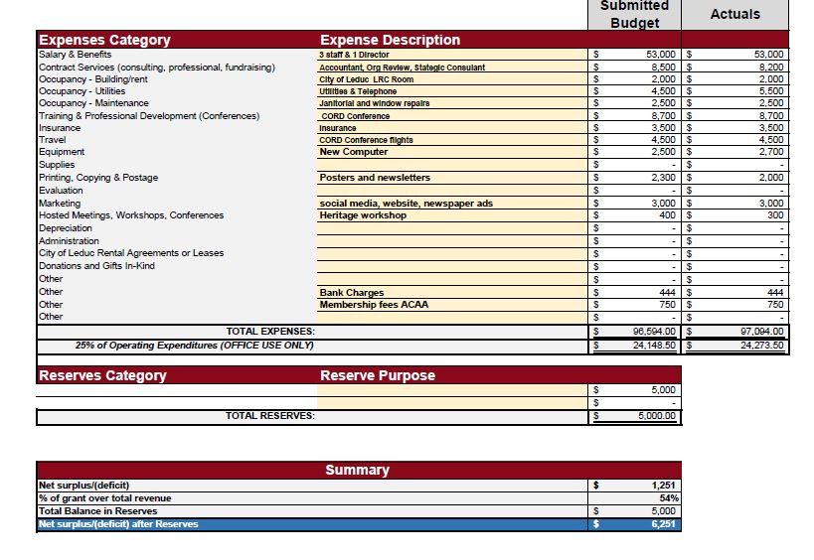
Final Report Budget Template
– Example

Slide 10
Reminders
All Financial Statements require independent review and signatures by two (2) Board Members. This cannot be the Treasurer .
It is best practice to show a comparable of your current year to the previous in your financials
Organizations must remain in good standing with payments with the City of Leduc
Organizations are required to notify City of Leduc Administration and provide documentation for:
Updates to incorporation documents
Copies or changes of lease/licenses or rental agreements with the City of Leduc

Slide 11
Final Reporting
Final Reporting Deadline – January 31, 2025
2025 Application Notifications – December 2024
Funding Payments for 2025– February-March 2025
Further clarifications or questions, please do not hesitate to contact:
Office hours: 8:30 am – 4:30 pm
Thank You!
Community & Social Development
Grants@Leduc.ca
(780) 980-7117

